Slide 1
NYPD Shooting Incidents
Safety trends and shootings racial disparities
Notes:
In this project I will explore NYC's safety trends using data from 2006 to 2022. By analyzing murder rates over the years and looking at race-related shootings, I aim to highlight patterns and trends, as well as disparities among race-on-race shootings. Additionally, I will build a model to predict future trends and help with strategic interventions and informed decision-making.

Slide 2
Importing packages and reading data
library(tidyverse)
library(ggplot2)
library(dplyr)
library(tidyr)
url_nypd <- "https://data.cityofnewyork.us/api/views/833y-fsy8/rows.csv?accessType=DOWNLOAD"
nypd_raw_data <- read_csv(url_nypd)
Notes:
The NYPD Shooting data set provides detailed information on shooting incidents in New York City, including dates, times, locations, demographics of perpetrators and victims.
I will first import necessary libraries:
tidyverse, dplyr, tidyr – to use for data transformation and data wrangling
ggplot2 – to use for plotting and visualizations
Read the CSV file from the URL and store it in a data frame.

Slide 3
Cleaning the data
nypd_clean_data <- nypd_raw_data %>%
select(c(
"DATE" = "OCCUR_DATE",
"TIME" = "OCCUR_TIME",
…
"VIC_RACE"
)) %>%
mutate(
DATE = mdy(DATE),
PRECINCT = as.integer(PRECINCT),
YEAR = year(DATE),
MURDER_FLAG = as.integer(MURDER_FLAG)
)
Notes:
Before conducting the analysis, the data set undergoes cleaning to standardize column names, convert data types, handle missing values, and resolve inconsistencies.
For example I will convert date strings in the Date columns to R DATE objects.
Also the MURDER_FLAG is converted to an integer.

Slide 4

Summary statistics
summary(nypd_clean_data)
missing_counts <- colSums(is.na(nypd_clean_data))
missing_counts
Notes:
To better understand the data and to detect quality issues I will compute the summary statistics for each variable (column) in the data frame and display the count of missing
values for each column. Missing values will be addressed individually for each subsequent analysis and visualization.

Slide 5
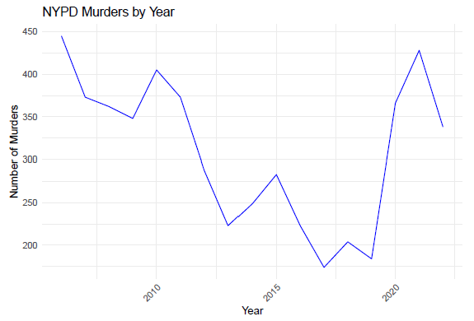
Analysis and Visualizations Murders by Year
murders_by_year <- nypd_clean_data %>%
group_by(YEAR) %>%
summarize(Murders = sum(MURDER_FLAG))
ggplot(murders_by_year, aes(x = YEAR, y = Murders)) +
geom_line(color = "blue") + # Use geom_line for line graph
Labs(title = "NYPD Murders by Year",
x = "Year",
y = "Number of Murders") +
theme_minimal() +
theme(axis.text.x = element_text(angle = 45, hjust = 1))
Notes:
In order to perform a temporal analysis of fatal shootings, first I calculate the total number of murders reported by the NYPD for each year. The data is grouped by year, and the sum of murders is calculated using the summarize() function.
The results are visualized in a line plot. From the plot we note a downward trend pre 2020, with a steep incline after 2020. Also note that there were no missing values in the columns of interest.

Slide 6
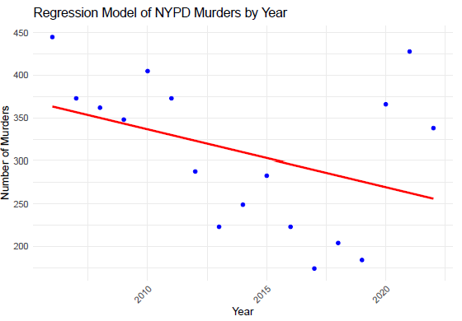
Regression Model Murders by Year
model <- lm(Murders ~ YEAR, data = murders_by_year)
ggplot(murders_by_year, aes(x = YEAR, y = Murders)) +
geom_point(color = "blue") +
geom_smooth(method = "lm", se = FALSE, color = "red") +
labs(title = "Regression Model of NYPD Murders by Year",
x = "Year",
y = "Number of Murders") +
theme_minimal() +
theme(axis.text.x = element_text(angle = 45, hjust = 1))
Notes:
Using the linear model “lm“ function, I fit and subsequently visualize the relationship between time and the number of murders. We can refine and enhance the linear regression model by exploring options such as feature engineering
and/or polynomial regression in order to further improve the model’s predictive performance.

Slide 7
Analysis and Visualizations Race-on-race Shootings
nypd_clean_data <- nypd_clean_data %>%
filter(PERP_RACE != 'U' &
VIC_RACE != 'U' &
PERP_RACE != '(null)' &
VIC_RACE != '(null)' &
PERP_RACE != 'UNKNOWN' &
VIC_RACE != 'UNKNOWN’)
nypd_clean_data$PERP_RACE <-
replace(nypd_clean_data$PERP_RACE,
nypd_clean_data$PERP_RACE == "AMERICAN INDIAN/ALASKAN NATIVE", "NATIVE")
…
nypd_clean_data$VIC_RACE <-
replace(nypd_clean_data$VIC_RACE,
nypd_clean_data$VIC_RACE == "ASIAN / PACIFIC ISLANDER", "ASIAN")
Notes:
Performing a race-on-race shootings analysis necessitates the removal rows with missing and unknown race information to uphold data integrity and ensure accurate analysis.

Slide 8
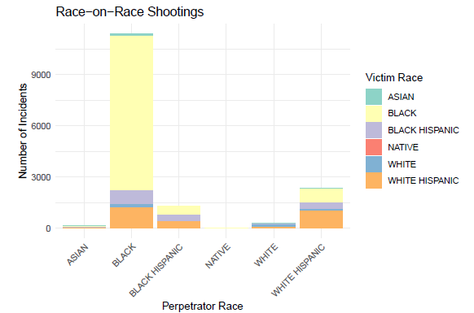
Analysis and Visualizations Race-on-race Shootings
ggplot(nypd_clean_data, aes(x = PERP_RACE, fill = VIC_RACE)) +
geom_bar() +
labs(title = "Race-on-Race Shootings",
x = "Perpetrator Race",
y = "Number of Incidents",
fill = "Victim Race") +
theme_minimal() +
theme(axis.text.x = element_text(angle = 45, hjust = 1)) +
scale_fill_brewer(palette = "Set3")
Notes:
The analysis and plot highlight disparities and patterns in the occurrence of shootings between individuals of the same race (in particular BLACK on BLACK shootings). Factors such as socioeconomic status, community dynamics, and historical context likely play significant roles in shaping these patterns.

Slide 9
Sources of Bias
Underreporting
Selection
Sampling
Data Collection
Data Quality Issues
Contextual Factors
Personal Bias
Notes:
When performing the analysis above, we must consider any potential sources of bias such as (above):
Awareness of these biases and rigorous evaluation of data set limitations are crucial for conducting the analysis and interpreting results accurately.

Slide 10
Conclusion
Notes:
The analysis of murders by year and race-on-race shootings provides valuable insights into the dynamics of violent crime and racial disparities in New York City.
The data reveals fluctuations in homicide rates over time, with periods of decline followed by recent increases.
Similarly, the race-on-race shootings analysis sheds light on disparities in the prevalence of shootings within racial groups.
This analysis underscores the importance of ongoing monitoring and proactive measures to address emerging trends and mitigate the impact of violent crime on communities.

